Slide 1
Capstone Project
Yes Bank Stock Closing Price Prediction

Slide 2
Concepts
Introduction
Understanding the dataset
Problem Statement
Approach
Python Libraries
Time series model
Correlation
Linear Regression
Regularization
XGboost
KNN
Performance Metrics
Conclusion

Slide 3
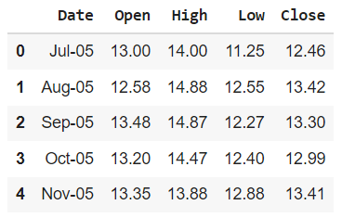
INTRODUCTION
Objective: To come up with a supervised machine learning algorithm and improve it to predict the stock’s closing price.
Dataset: The dataset contains the information about stock prices of Yes bank from July-2005 to November-2020.There are no null values.Sample dataset:

Slide 4
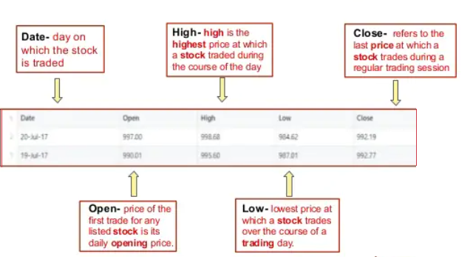
Understanding the dataset

Slide 5
Problem Statement
Yes Bank is a well-known bank in the Indian financial domain. Since 2018, it has been in the news because of the fraud case involving Rana Kapoor. Owing to this fact, it was interesting to see how that impacted the stock prices of the company and whether Time series models or any other predictive models can do justice to such situations.
The main objective is to come up with a model to predict the stock’s closing price of the month.

Slide 6
APPROACH
From the dataset(185 rows) 80% is taken for training and 20% is used for validation.
Converted the date field to date-time object for analysis.
Started with time series models which require only target variables. (ARIMA , PROPHET, Moving Average).
Since the target variable is correlated with independent variables implemented Linear Regression.
To improve the model implemented below techniques:
Regularisation: Lasso and Ridge regression
Boosting algorithm: XGboost
Implemented KNN to check if the model gives high accuracy than Linear Regression.

Slide 7
Python Libraries
The python scientific computing library numpy was used along with the data analysis library pandas in order to convert these CSV files into panda data frames.
Used datetime library to convert date column values to date-time objects.
To implement supervised ML algorithms and to calculate the accuracy sklearn.
Matplotlib and seaborn are used to plot the graphs for data visualization.

Slide 8
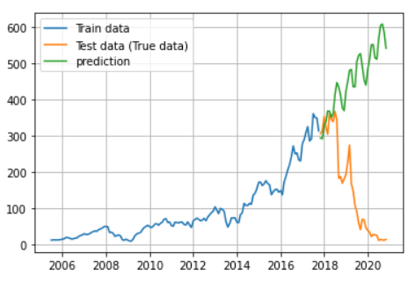
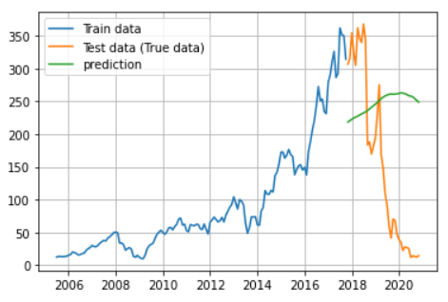
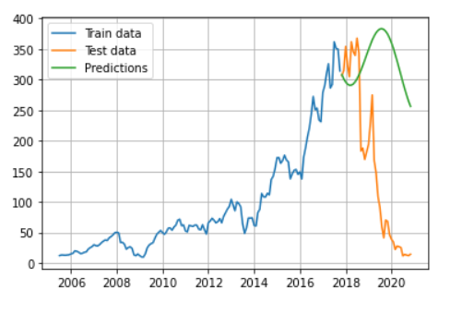
Time Series models
ARIMA
Moving Average
PROPHET
Methods which are based on target variable are performing poorly. One of the reason for this can be strong correlation between target and input variables which means target variables are not independent.

Slide 9
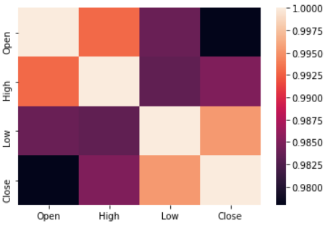
Correlation

Slide 10
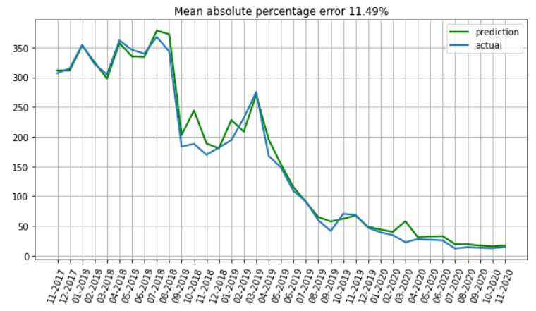
Linear Regression

Slide 11
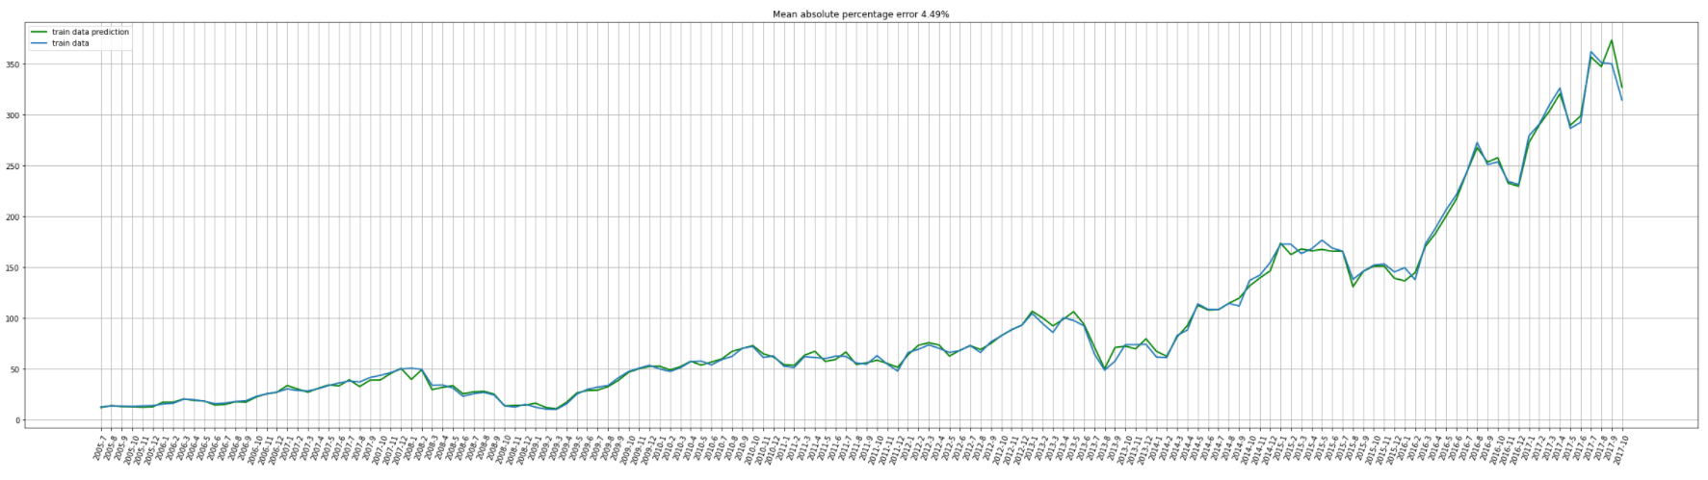

Slide 12
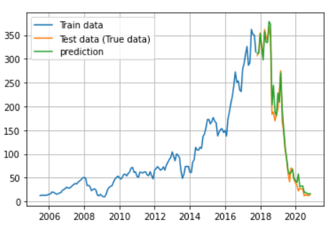
Overview of Linear regression performance

Slide 13
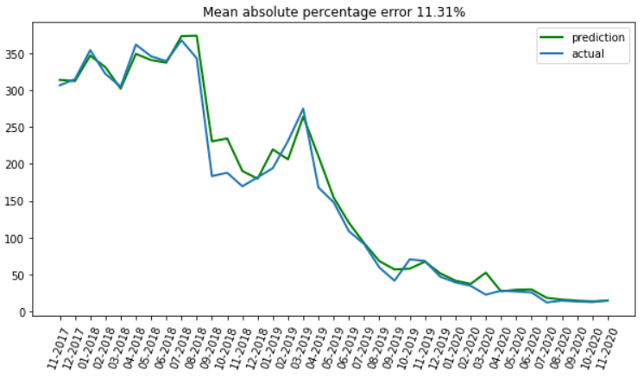
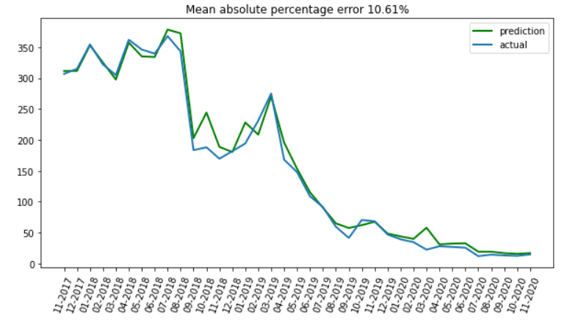
Regularization
Lasso
Ridge

Slide 14
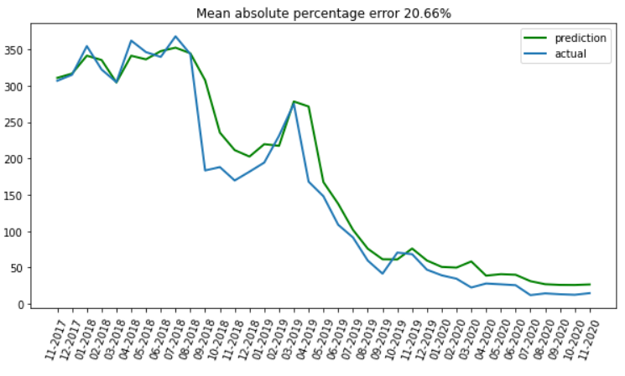
Boosting
XGboost

Slide 15
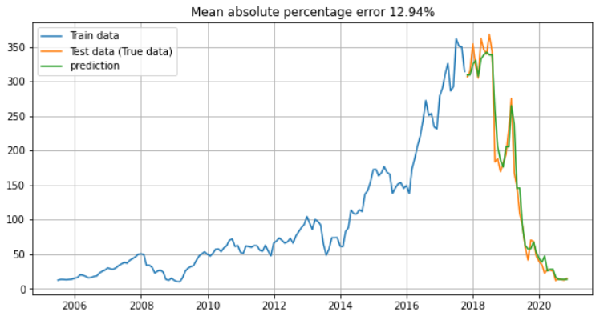
KNN

Slide 16
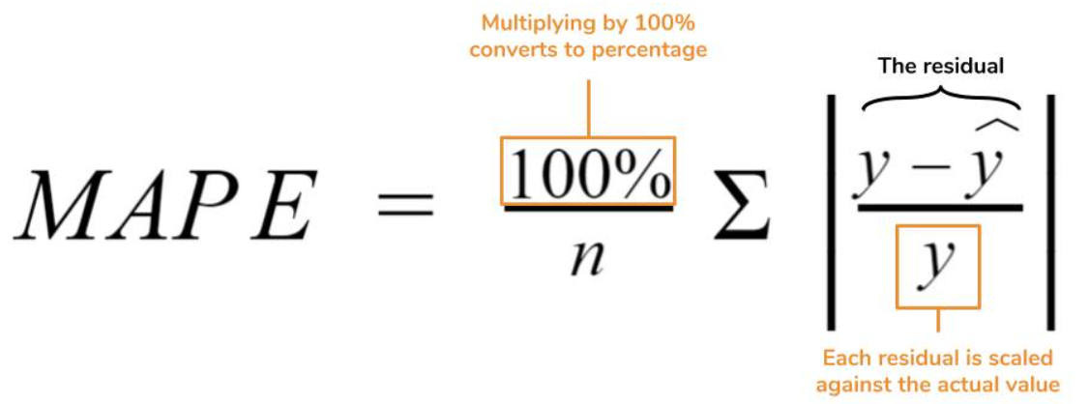
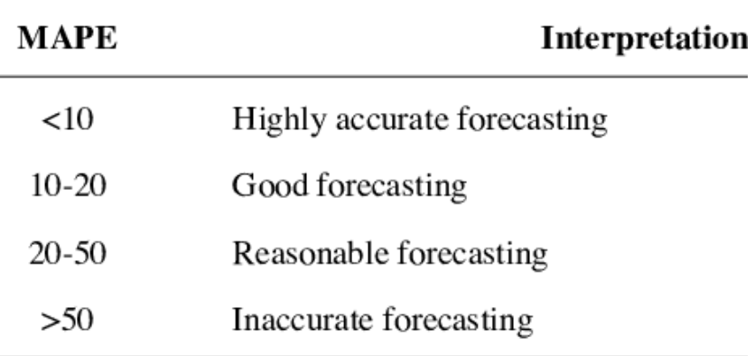
Performance metrices
MAPE is a relative measure which provides easy way of measuring accuracy of the models and to compare them.
MAPE of Linear Regression is 11.49% on training set and 4.49% on validation data. Hence Linear Regression model is not overfitting or underfitting.
MAPE of Ridge and KNN models are 10.61% and 12.94% respectively which is a good forecasting.

Slide 17
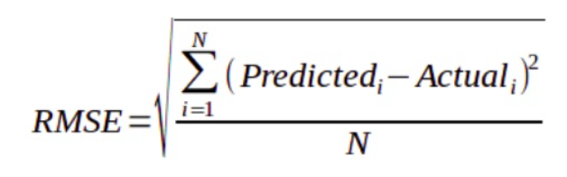
RMSE is calculated by sum of square of prediction error divided by number of data points
RMSE of the model Linear Regression and ridge regression is 16.03.
RMSE on applying KNN model is 21.6.

Slide 18
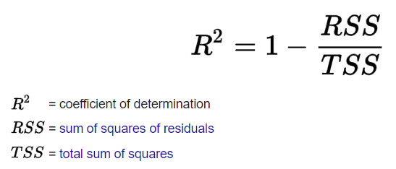
R-Squared is a statistical measure that represents goodness of fit of regression model.The closer the value of R-Squared to 1, the better is the model fitted.
R-Squared value on Linear regression model and ridge techniques are 0.98.
R-Squared value of KNN model is 0.97.

Slide 19
Conclusion
Target variable is strongly dependent on input variables
Target based methods like ARIMA, Prophet, Moving Average are preforming poorly as Target variable is dependent.
Linear Regression is performing better than any other model.
Apart from Linear regression , Ridge and KNN models are showing good performance.
We are getting error of around 10% and may not be able to reduce this using any linear models as we have small amount of data, relation between target and input variables may be nonlinear.

Slide 20
Teammates:
Satish Chandra Katikala– ksatish@iitg.ac.in
Raavi Sowmini Chowdary – sonysowmini@gmail.com

